Slide 1


WildGuard AI
Anonymous Wildlife Crime Reporting Chatbot
Using Cyber Intelligence & AI to Combat Illegal Wildlife Trade
Team: Sehaj Kashyap | Bhumika Koushal | Krishika Gupta | Sandeep Kumar
Event: CUJ Hackathon 2025

Slide 2
The Crisis We're Addressing
The Crisis We're Addressing
Fear of Criminals
Lack of Awareness
Citizens avoid reporting due to fear of retaliation.
People don't know how or where to report.
Complicated Reporting Systems
No Anonymity & Delayed Action
Processes are bureaucratic & slow.
Authorities receive late or incomplete information, affecting rescue operations.

Slide 3
Solution
Turning Fear into Action with AI
AI-Powered Detection
Cross-Platform Access
Anonymous Reporting
Citizens can safely report without revealing identity.
Recognizes species, detects threats, assesses severity.
Available on Web, WhatsApp, Telegram, and public kiosks.
Empowering citizens to protect wildlife safely & anonymously.

Slide 4
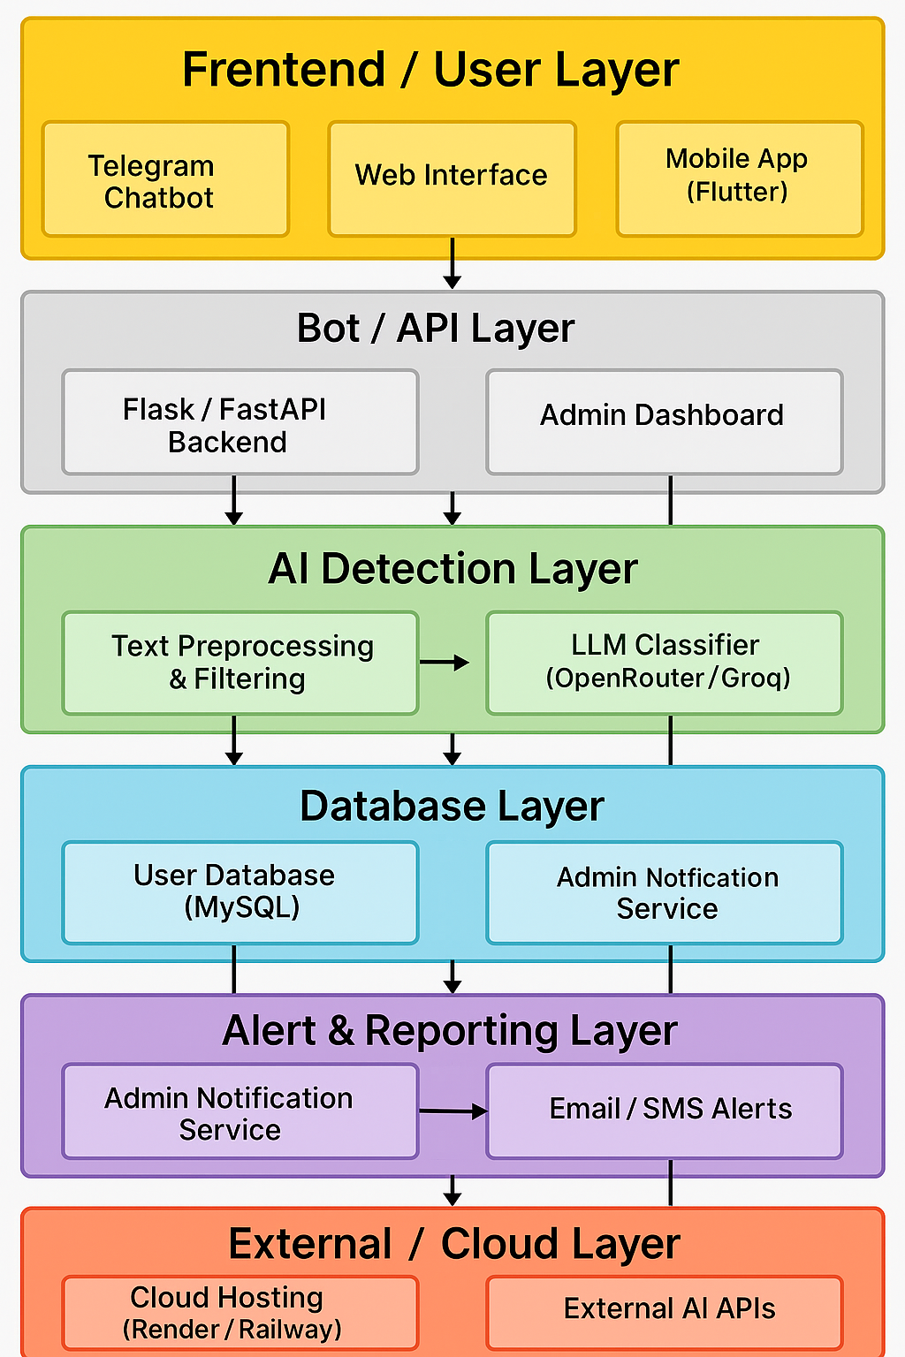






WildGuard AI – System Architecture View
Citizen User
Conversational Layer
OPEN ROUTER LLM + LangChain + RASA
AI Processing Layer
Computer Vision + Metadata Removal + Threat Analysis
Backend Infrastructure
Flask/FastAPI | Encrypted Cloud | IP Masking
Database Layer
SQLite/MongoDB | Encrypted Evidence Storage
Authority Dashboard
Tailwind UI | Hotspot Map | Case Analytics

Slide 5





Why WildGuard AI is Unique
Challenge
WildGuard AI Advantage
Lack of secure reporting
True anonymous chatbot
Complex interfaces
Simple conversational UI
Manual data handling
Automated AI detection & encryption
Delayed alerts
Real-time dashboard notifications
Impact Highlights:
100% Anonymous Citizen Protection
24/7 Availability across platforms
Real-Time AI Threat Detection
Improved coordination between forest & police units

Slide 6
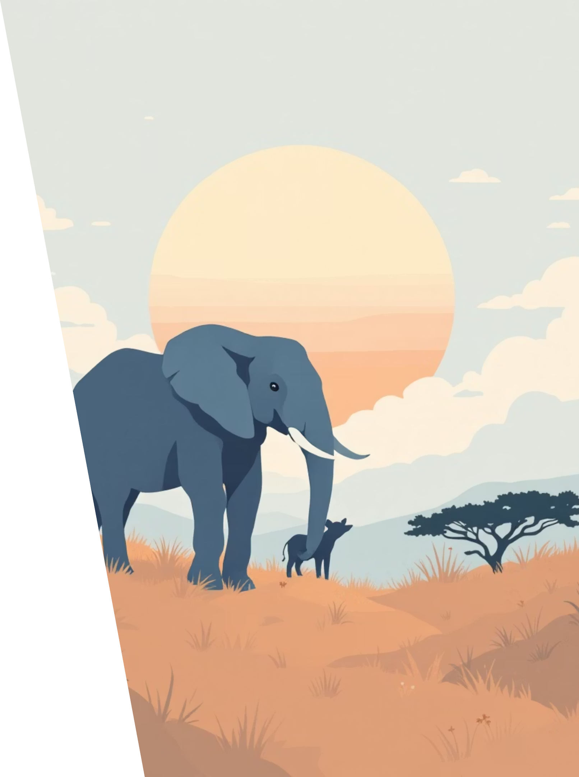
The Road Ahead
Future Enhancements:
1
Future Platform Expansion (Currently Telegram Bot, expandable to other platforms)
2
HTTPS Inspection for Secure Evidence Transfer
3
In-House Model Training (Training our own AI model for better accuracy)
4
Predictive Crime Hotspot Mapping
"Together, we can stop illegal wildlife trade — one report at a time."

Slide 7
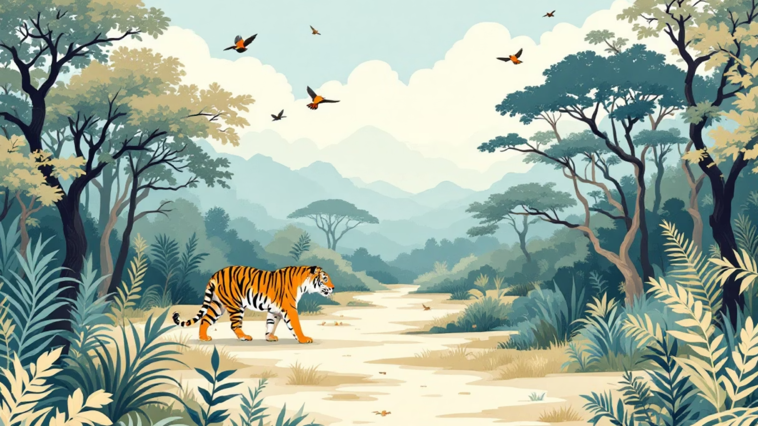
WildGuard AI
Team CyberSpecies | CUJ Hackathon 2025
Together, we can stop illegal wildlife trade — one report at a time.

